Slide 1
Learnings from case study
Content
Feature Engineering
Problem Statement – Model Evaluation Metrics
Classification model- Pipeline Architecture
Best Pipeline selection
Best practices and next steps

Slide 2
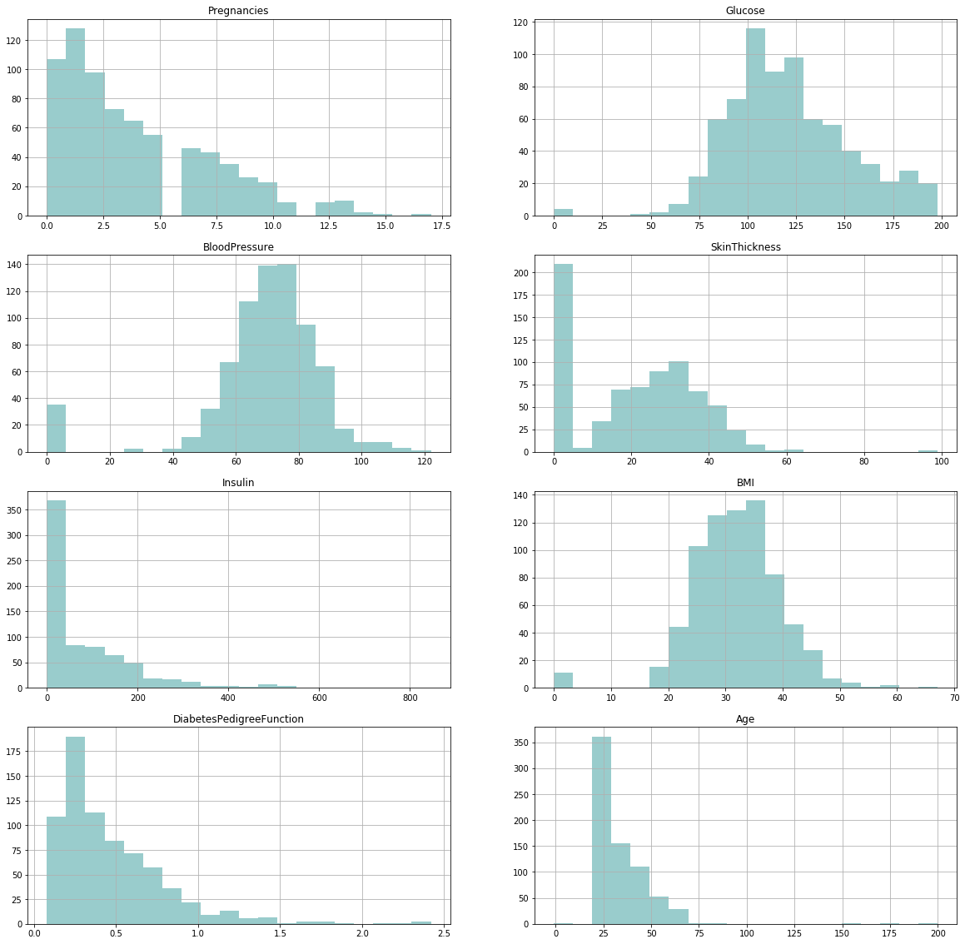
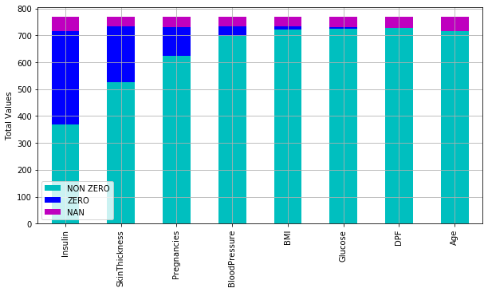
1. Problem Statement : Feature engineering
Frequency Distribution of Features
Zeros and Nan value distribution by Feature
Feature Engineering :
Process NaN values and replace them with (constant value imputer (mean , median,..) , random value from existing not NaN values , multivariate imputer or KNN imputer)
Assess the signification of the zeros and how to process zeros for each feature
Replace illogical data with NaN
→ Ensure no leak from test data to train data

Slide 3
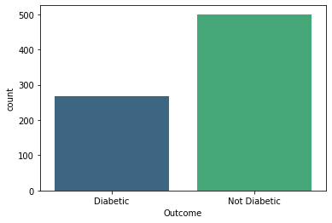
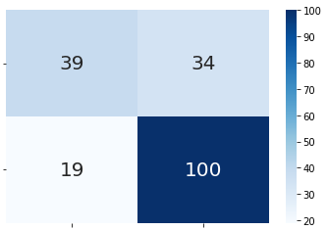
2. Problem Statement : Key Metrics to assess the model
 |  | TRUE
 |  | P | N
PREDICTED | P | TRUE POSITIVE | FALSE POSITIVE
 | N | FALSE NEGATIVE | TRUE NEGATIVE
500
(65%)
500
268
(35%)
Accuracy = (TP+TN)/(TP+FP+FN+TN) | Percentage of total correct predictions (could be selected because there is no big imbalance)
Recall = TP/(TP+FN) | Percentage of correct diabetic predictions from total actual diabetics (Important metric : to avoid having high actual diabetic cases wrongly predicted)
Precision= TP/(TP+FP) | Percentage of correct diabetic predictions from predicted diabetics
F1_Score =2(1/Precision+1/Recall) | Balance between Recall and Precision
Area Under Curve ROC | Correct diabetic predictions rate vs. False diabetic prediction rate compared to random prediction

Slide 4
3. Pipeline Architecture
Pipeline
Feature Engineering
Imputer Iteration
Imputer hyperparameter grid search
Only NaN
All Zeros & NaN
(Sel. Features 0&nan)
Simple imputer
KNN imputer
Simple imputer
KNN imputer
Simple imputer
KNN imputer
Fit on training data
Scaler iteration
Scaler
MinMax
Scaler
Standard
Scaler
Fit on training data
Classification model
Model Hyperparameter Grid Search
Random Forest
Support Vector Machine
Naïve Bayes
KNN
Gradient boosting
Logistic Regression
K-Fold Cross Validation (training)
(iterate cross validation if score variance is high)
Model Stacking
Model Bagging
ANN

Slide 5
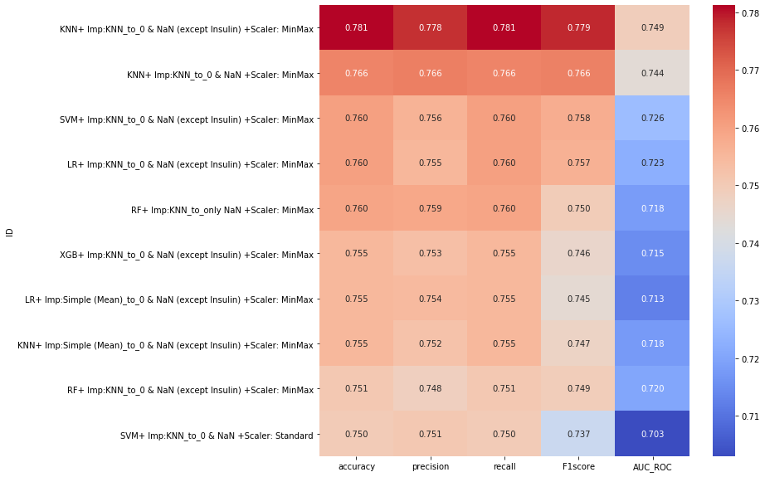
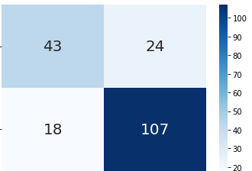
4. Best classification pipelines
 |  | TRUE
 |  | P | N
PREDICTED | P | TRUE POSITIVE | FALSE POSITIVE
 | N | FALSE NEGATIVE | TRUE NEGATIVE
For this case study highest accuracy score corresponds to highest Recall , F1 Score and the best ROC

Slide 6
5. Best Practices & Next Steps
Best Practices
Stratify the imbalance on data split to maintain minority class ratio
Avoid leaking of information from testing set to training set
Iterate cross validation in case of high score variance
Include the preprocessing parameters in the pipeline grid search
Next Steps : Evaluate the performance of other advanced classification techniques
Create a grid search on ANN artificial neural network parameters (# hidden layers, # neurons per layer, dropout ratio, learning rate, loss function)
Test model stacking : by stacking 2 models or more in the grid search pipeline

